Slide 1
Remote Invocation
Tasniya Ahmed
Lecturer
IIT, NSTU

Slide 2
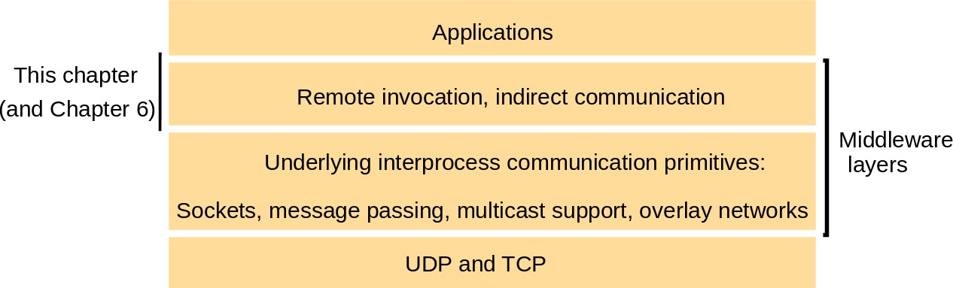
Remote invocation
5 Remote invocation
The remote procedure call (RPC) approach extends the common abstraction of the procedure call to distributed environments, allowing a calling process to call a procedure in a remote node as if it is local.
•
•
Remote method invocation (RMI) is similar to RPC but for distribut
with added benefits in terms of using object-oriented programming concepts in distributed systems and also extending the concept of an object reference to the global distributed environments, and allowing the use of object references as parameters in remote invocations.
Figure 5.1 Middleware layers

Slide 3
Request-reply protocols
Introduction
Request-reply protocols 2.RPC
3.RMI – in 1990s – RMI extension allowing a local object to invoke methods of remote objects
Request-reply protocols
typical client-server interactions – request-reply communication is synchronous because the client process blocks until the reply arrives
Asynchronous request-reply communication – an alternative that may be useful in situations where clients can afford to retrieve replies later

Slide 4
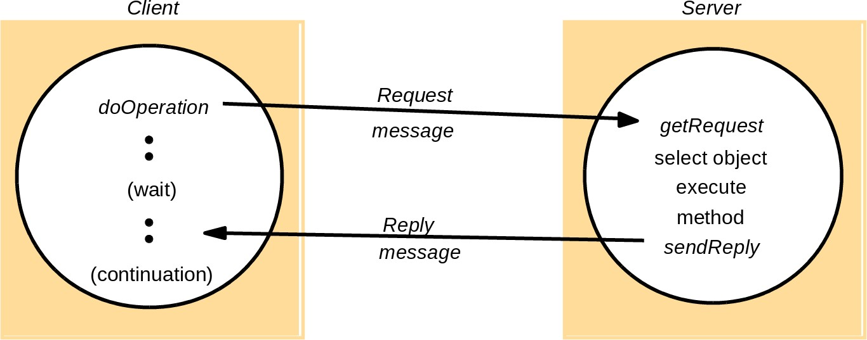
Request-reply protocols
196Remote invocation5.2
The request-reply protocol
doOperation, getRequest and sendReply
Figure 5.2 Request-reply communication
doOperation by clients to invoke remote op.; together with additional arguments; return a byte array. Marshaling and unmarshaling!
getRequest by server process to acquire service requests; followed by
sendReply send reply to the client

Slide 5
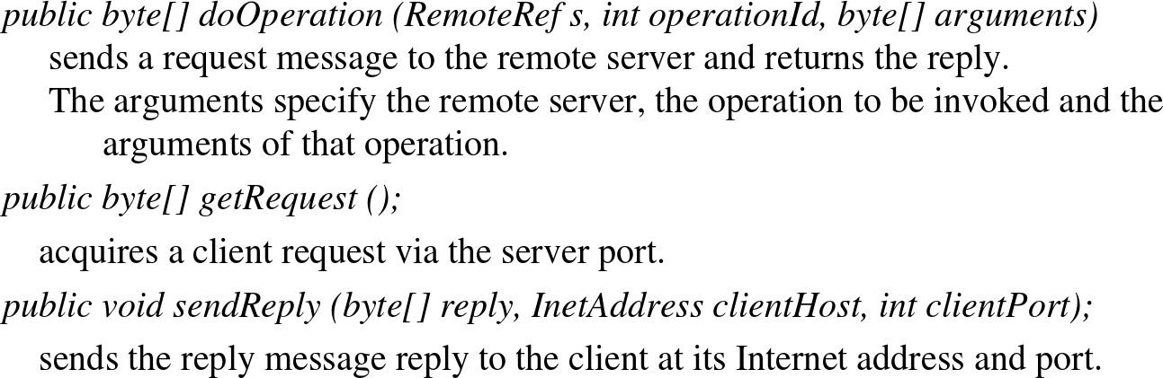
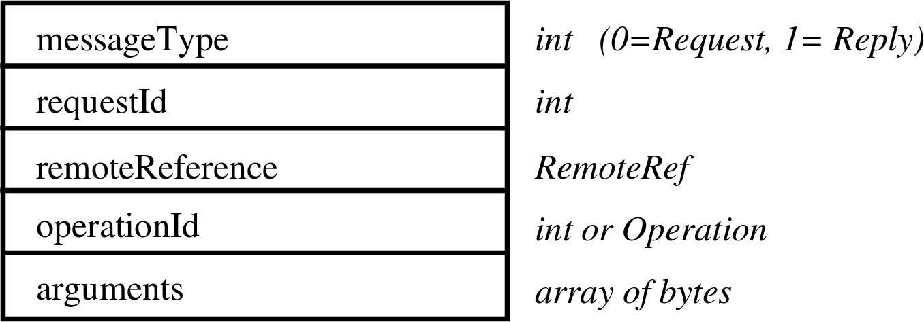
Request-reply protocols
197Remote invocation5.2
Figure 5.3 Operations of the request-reply protocol
Figure 5.4 Request-reply message structure

Slide 6
Request-reply protocols
198Remote invocation5.2
Message identifiers
1. requestID – increasing sequence of integers by the sender 2.server process identifier – e.g. internet address and port
Failure model of the request-reply protocol
A. UDP datagrams
communication failures (omission failures; sender order not guaranteed )
+ possible crash failures
action taken when a timeout occurs depends upon the delivery guarantees being offered
Timeouts – scenarious for a client bahaviour
Discarding duplicate request messages – server filtering out duplicates

Slide 7
199Remote invocation5.2
Request-reply protocols
Lost reply messages
idempotent operation
with the same effect as if it had been performed exactly once
– an operatio
History
retransmission by server ... problem with memory size ... ←− can be cured by the knowledge that the message has arrived, e.g.:
clients can make only one request at a time ⇒ server can interpret each request as an acknowledgement of its previous reply!
Styles of exchange protocols Three different types of protocols (Spector [1982]):
the request (R) protocol
– No confirmation needed from server - client can continue right away – UDP-implementation

Slide 8
Request-reply protocols
200Remote invocation5.2
the request-reply (RR) protocol
– most client-server exchanges
the request-reply-acknowledge reply (RRA) protocol Figure 5.5 RPC exchange protocols
Name | Messages sent by
 | Client | Server | Client
R RR RRA | Request Request Request | Reply Reply | Acknowledge reply

Slide 9
Request-reply protocols
201Remote invocation5.2
B. TCP streams to implement request-reply protocol
TCP streams
transmission of arguments and results of any size
flow-control mechanism
⇒ no need for special measures to avoid overwhelming the recipient
request and reply messages are delivered reliably
⇒ no need for
retransmission
filtering of duplicates
histories

Slide 10
202Remote invocation5.2 Request-reply protocols
Example: HTTP request-reply protocol
fixed set of methods (GET, PUT,POST, etc)
In addition to invoking methods on web resources:
Content negotiation: information – what data representations client can accept (e.g, language, media type)
Authentication: Credentials and challenges to support password-style authentication
– When a client receives a challenge, it gets the user to type a name and password and submits the associated credentials with subsequent requests
HTTP – implemented over TCP
Original version of the protocol – client-server interaction steps:
The client requests and the server accepts a connection at the default server port or at a port specified in the URL

Slide 11
Request-reply protocols
203Remote invocation5.2
The client sends a request message to the server
The server sends a reply message to the client
The connection is closed Later version
persistent connections – connections remain open ofer a series of request-reply exchanges
client may receive a message from the server saying that the connection is closed while it is in the middle of sending another request or requests
browser will resend the requests without user involvement, provided that the operations involved are idempotent (like GET-method)
otherwise – consult with the user
Requests and replies are marshalled into messages as ASCII text strings, but

Slide 12
204Remote invocation5.2 Request-reply protocols
– resources can be represented as byte sequences and may be compressed
Multipurpose Internet Mail Extensions (MIME) – RFC 2045 – standard for sending multipart data containing, for example, text, images and sound
HTTP methods
GET: Requests the resource whose URL is given as its argument. If the URL refers to data, then the web server replies by returning the data identified
– Arguments may be added to the URL; for example, GET can be used to send the contents of a form to a program as an argument
HEAD: identical to GET, but does not return any data but instead, all the infor- mation about the data
POST: data supplied in the body of the request, action may change data on the server

Slide 13
205Remote invocation5.2 Request-reply protocols
PUT: Requests that the data supplied in the request is stored with the given URL as its identifier, either as a modification of an existing resource or as a new resource
DELETE: deletes the resource identified by the given URL
OPTIONS: server supplies the client with a list of methods it allows to be applied to the given URL (for example GET, HEAD, PUT) and its special requirements
TRACE: The server sends back the request message. Used for diagnostic purposes
operations PUT and DELETE – idempotent, but POST is not necessarily

Slide 14

Request-reply protocols
206Remote invocation5.2
Message contents
Figure 5.6 HTTP Request message
Figure 5.7 HTTP Reply message

Slide 15
Remote procedure call (RPC)
Remote procedure call (RPC)
Concept by Birrell and Nelson [1984]
Design issues for RPC
Three issues we will look:
the style of programming promoted by RPC – programming with interfaces
the call semantics associated with RPC
the key issue of transparency and how it relates to remote procedure calls
Programming with interfaces
Interfaces in distributed systems: In a distributed program, the modules can run in separate processes
service interface – specification of the procedures offered by a server, defining the types of the arguments of each of the procedures

Slide 16
208Remote invocation5.3 Remote procedure call (RPC)
number of benefits to programming with interfaces in distributed systems (separa- tion between interface and implementation):
programmers are concerned only with the abstraction offered by the service interface and need not be aware of implementation details
not need to know the programming language or underlying platform used to implement the service (heterogeneity)
implementations can change as long as the interface (the external view) remains the same
Distributed nature of the underlying infrastructure:
not possible for a client module running in one process to access the variables in a module in another process
parameter-passing mechanisms used in local procedure calls (e.g., call by value; call by reference) – not suitable when the caller and procedure are in different processes

Slide 17
209Remote invocation5.3
– parameters as input or output
addresses cannot be passed as arguments or returned as results of calls to remote modules
Interface definition languages (IDLs)
designed to allow procedures implemented in different languages to invoke one another
IDL provides a notation for defining interfaces in which each of the parameters of an operation may be described as for input or output in addition to having its type specified
Remote procedure call (RPC)

Slide 18
210Remote invocation5.3 Remote procedure call (RPC)
Figure 5.8 CORBA IDL example
, ,
/ /I nf i l ePerson.i d l
s t r u c tPerson {
s t r i n gname ; s t r i n gp l a c e ; longyear ;
} ;
i n t e r f a c eP e r s o n L i s t {
readonlya t t r i b u t es t r i n gl i s t n a m e
;
voidaddPerson ( inPersonp ) ;
voidget Person ( ins t r i n gname longnumber ( ) ;
, outPersonp ) ;
} ;
z

Slide 19
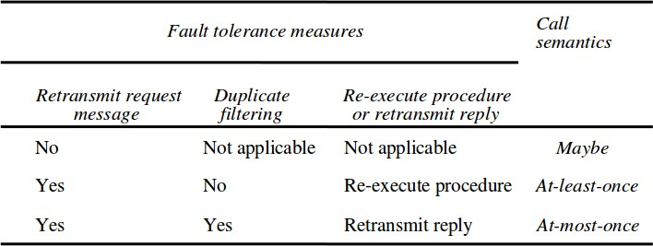
211Remote invocation5.3 Remote procedure call (RPC)
RPC call semantics
doOperation implementations with different delivery guarantees:
Retry request message
Duplicate filtering
Retransmission of results Figure 5.9 Call semantics

Slide 20
212Remote invocation5.3 Remote procedure call (RPC)
Maybe semantics – remote procedure call may be executed once or not at all
when no fault-tolerance measures applied, can suffer from
omission failures (the request or result message lost)
crash failures
At-least-once semantics – can be achieved by retransmission of request messages
types of failures
crash failures when the server containing the remote procedure fails
arbitrary failures – in cases when the request message is retransmitted, the remote server may receive it and execute the procedure more than once, possibly causing wrong values stored or returned
If the operations in a server can be designed so that all of the procedures in their service interfaces are idempotent operations, then at-least-once call semantics may be acceptable

Slide 21
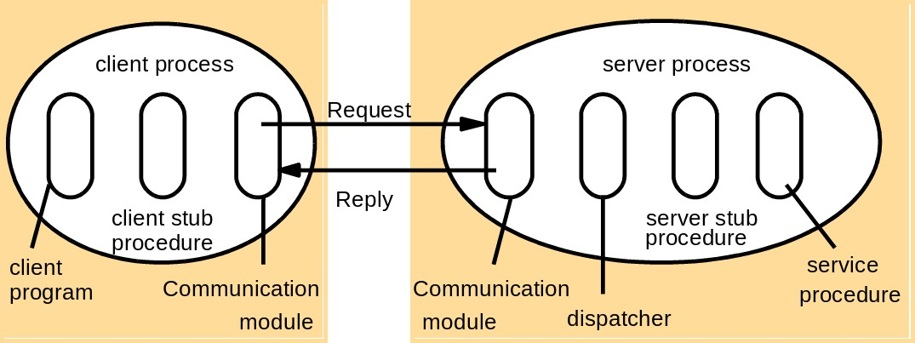
213Remote invocation5.3 Remote procedure call (RPC)
At-most-once semantics – caller receives either a result or an exception
Transparency
at least location and access transparency
consensus is that remote calls should be made transparent in the sense that the syntax of a remote call is the same as that of a local invocation, but that the difference between local and remote calls should be expressed in their interfaces
5.3.2 Implementation of RPC
Figure 5.10 Role of client and server stub procedures in RPC

Slide 22
214Remote invocation5.3 Remote procedure call (RPC)
stub procedure behaves like a local procedure to the client, but instead of executing the call, it marshals the procedure identifier and the arguments into a request message, which it sends via its communication module to the server
RPC generally implemented over request-reply protocol
general choices:
at-least-once or
at-most-once

Slide 23
217Remote invocation5.4
Remote method invocation (RMI)
Remote method invocation (RMI)
Remote method invocation (RMI) closely related to RPC but extended into the
world of distributed objects
a calling object can invoke a method in a potentially remote object. As with RPC, the underlying details are generally hidden from the user
Similarities between RMI and RPC, they both:
support programming with interfaces
typically constructed on top of request-reply protocols
can offer a range of call semantics, such as
at-least-once
at-most-once
similar level of transparency –

Slide 24
218Remote invocation5.4 Remote method invocation (RMI)
local and remote calls employ the same syntax
remote interfaces
* typically expose the distributed nature of the underlying call e.g. sup- porting remote exceptions
RMI added expressiveness for programming of complex distributed applications and services:
full expressive power of object-oriented programming
use of objects, classes and inheritance
objectoriented design methodologies and associated tools
all objects in an RMI-based system have unique object references (independent of they are local or remote)
object references can also be passed as parameters ⇒ offering significantly richer parameter-passing semantics than in RPC

Slide 25
219Remote invocation5.4
Design issues for RMI
Transition from objects to distributed objects
The object model
some langueages allow accessing object instance variables directly (C++, Java) – in distributed object system, object’s data can be accessed only with the help of its methods
Object references: to invoke a method object’s reference and method name are given
Interfaces: definition of the signatures of a set of methods without their implementation
Actions: initiated by an object invoking a method in another object three effects of invocation of a method:
The state of the receiver may be changed

Slide 26
220Remote invocation5.4 Remote method invocation (RMI)
A new object may be instantiated, for example, by using a constructor in Java or C++
Further invocations on methods in other objects may take place
Exceptions: a block of code may be defined to throw an exception; another block
catches the exception
Garbage collection: ...Java vs C++ case...
Distributed objects
Distributed object systems – different possible architectures
client-server architecture ... but also possibly:
replicated objects – for enhanced performance and fault-tolerance
migrated objects – enhanced availability and performance

Slide 27
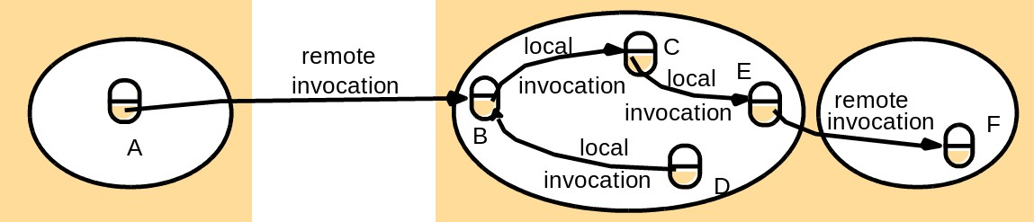
221Remote invocation5.4 Remote method invocation (RMI)
The distributed object model
Each process contains a collection of objects
objects that can receive remote invocations – remote objects
Figure 5.12 Remote and local method invocations
Remote object reference: identifier that can be used throughout a distributed sys- tem to refer to a particular unique remote object
Remote object references may be passed as arguments and results of remote method invocations
Remote interfaces: which of the object methods can be invoked remotely

Slide 28
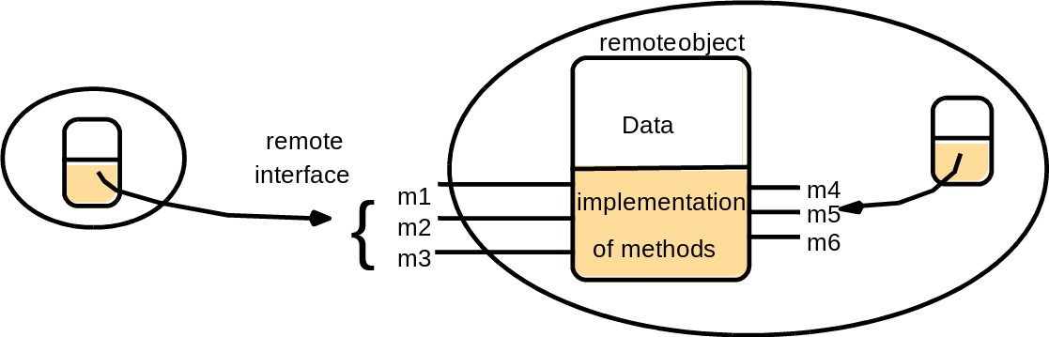
222Remote invocation5.4 Remote method invocation (RMI) Figure 5.12 A remote object and its remote interface
CORBA interface definition language (IDL)
Java RMI – keyword: Remote
, ,
NB! Remote interfaces cannot contain constructors!
z r
Actions in a distributed object system
remote reference of the object must be available to the invoker

Slide 29
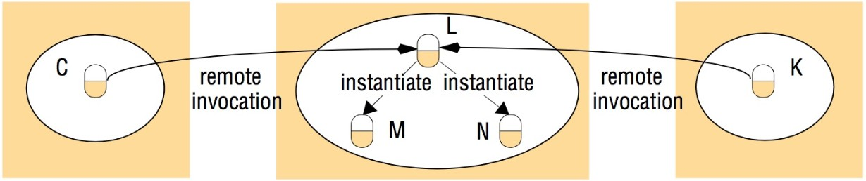
5.4Remote method invocation (RMI) Remote object references may be obtained as the results of remote method invocations
Figure 5.14 Instantiation of remote objects
Garbage collection in a distributed-object system:
if garbage collection supported by the language (e.g. Java) – also RMI should allow it + a module for distributed reference counting
Exceptions: usual exceptions + e.g. timeouts

Slide 30
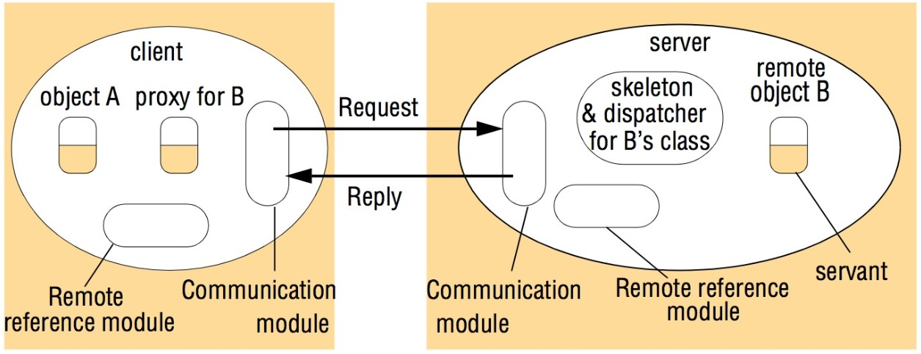
224Remote invocation5.4 Remote method invocation (RMI)
5.4.2 Implementation of RMI
Figure 5.15 The role of proxy and skeleton in remote method invocation
We will discuss:
What are the roles of each of the com- ponents?
What are communication and remote reference modules?
What is the role of RMI software that runs over them?
What is generation of proxies and why is it needed?
What is binding of names to their re- mote object references?
What is the activation and passivation of objects?

Slide 31
225Remote invocation5.4 Remote method invocation (RMI)
Communication module
– responsible for transfering request and reply messages between the client and server uses only 3 fields of the messages: message type, requestId and remote reference (Fig. 5.4)
communication modules are together responsible for providing a specified invoca- tion semantics, for example at-most-once
Remote reference module
responsible for translating between local and remote object references and for cre- ating remote object references
using remote object table – correspondence between local object references in that process and remote object references
An entry for all the remote objects held by the process
An entry for each local proxy

Slide 32
226Remote invocation5.4 Remote method invocation (RMI)
Actions of the remote reference module:
When a remote object is to be passed as an argument or a result for the first time, the remote reference module creates a remote object reference, and adds it to its table
When a remote object reference arrives in a request or reply message, the remote reference module is asked for the corresponding local object reference, which may refer either to a proxy or to a remote object
– In the case that the remote object reference is not in the table, the RMI software creates a new proxy and asks the remote reference module to add it to the table
Servants
instance of a class providing the body of a remote object
handles the remote requests passed on by the corresponding skeleton

Slide 33
227Remote invocation5.4
living within a server process
created when remote objects instantiated
remain in use until they are no longer needed (finally being garbage collected or deleted)
The RMI software
Proxy: making remote method invocation transparent to clients – behaving like a local object to the invoker
forwards invocation in a message to a remote object
hides the details of:
remote object reference
marshalling of arguments, unmarshalling of results
Remote method invocation (RMI)

Slide 34
228Remote invocation5.4 Remote method invocation (RMI)
– sending and receiving of messages from the client
just one proxy for each remote object for which a process holds a remote object reference
implements:
the methods in the remote interface of the remote object it represents
each method of the proxy marshals:
a reference to the target object
its own operationId and its arguments
... into a request message and sends it to the target
then awaits the reply message
unmarshals it and returns the results to the invoker

Slide 35
229Remote invocation5.4 Remote method invocation (RMI)
server has one dispatcher and one skeleton for each class representing a remote object
Dispatcher: receives request messages from the communication module
uses the operationId to select the appropriate method in the skeleton, passing on the request message
Skeleton: implements the methods in the remote interface
unmarshals the arguments in the request message
invokes the corresponding method in the servant
waits for the invocation to complete
marshals the result (together with any exceptions in a reply message to the send- ing proxy’s method)
Generation of the classes for proxies, dispatchers and skeletons
– generated automatically by an interface compiler

Slide 36
230Remote invocation5.4 Remote method invocation (RMI)
Dynamic invocation: An alternative to proxies
useful in applications where some of the interfaces of the remote objects cannot be predicted at design time
dynamic downloading of classes to clients (available in Java RMI) – an alterna- tive to dynamic invocation
Dynamic skeletons
Java RMI generic dispatcher and the dynamic downloading of classes to the server
(book Chapter 8 on CORBA)
Server and client programs
Server program : classes for
dispatchers, skeletons, supported servants +

Slide 37
231Remote invocation5.4
initialization section
creating and initializing at least one of the hosted servants, which can be used to access the rest
may also register some of its servants with a binder
Client program: classes for proxies for all of the remote objects that it will invoke
can use a binder to look up remote object references
Factory methods:
remote object interfaces cannot include constructors ⇒ servants cannot be created this way
Servants created either in
the initialization section or by
factory methods – methods that create servants

Slide 38
232Remote invocation5.4
Remote method invocation (RMI)
factory object – an object with factory methods
Any remote object that needs to be able to create new remote objects on demand for clients must provide methods in its remote interface for this purpose.
> Such methods are called factory methods
The binder in a distributed system
binder – a separate service that maintains a table containing mappings from textual
names to remote object references
binder used by:
servers to register their remote objects by name
clients to look them up
CORBA Naming Service – Chapter 8

Slide 39
233Remote invocation5.4 Remote method invocation (RMI)
The Java binder – RMIregistry, see case study on Java RMI in Section 5.5
Server threads
each remote invocation executed on a separate thread – (to avoid blocking)
... programmer has to take it into account...
Activation of remote objects
active-passive modes of service objects – to economise on resources
active object - available for invocation
passive object -
the implementation of its methods
its state in the marshalled form
Activation: creating an active object from the corresponding passive object by

Slide 40
234Remote invocation5.4 Remote method invocation (RMI)
creating a new instance of its class
initializing its instance variables from the stored state An activator is responsible for:
registering passive objects that are available for activation (involves recording the names of servers against the URLs or file names of the corresponding passive objects)
starting named server processes and activating remote objects in them
keeping track of the locations of the servers for remote objects that it has already activated
Java RMI – the ability to make remote objects activatable [java.sun.com IX]
– uses one activator on each server computer

Slide 41
235Remote invocation5.4 Remote method invocation (RMI)
CORBA case study in Chapter 8 describes the implementation repository
– a weak form of activator that starts services containing objects in an initial state
Persistent object stores
An object that is guaranteed to live between activations of processes is called a persis- tent object
generally managed by persistent object stores, which store their state in a mar- shalled form on disk
Object location
remote object reference – Internet address and port number of the process that created the remote object – to quarantee uniqueness

Slide 42
236Remote invocation5.4 Remote method invocation (RMI)
some remote objects exist in series of different processes, possibly on different computers, throughout their lifetime
location service – helping clients to locate remote objects from their remote object references
using database: remote object reference −→ probable current location
Distributed garbage collection
Java distributed garbage collection algorithm
server keeping track, which of its objects are proxied at which clients
– protocol for creation and removal of proxies with notifications to the server
based on no client proxies to an object exist and no local references either, garbage collection can remove the object at the server
(more details in TextBook Section 5.4.3)

Slide 43
237Remote invocation5.4 Remote method invocation (RMI)
Leases in Jini
references to a certain object are leased to other (outside) processes
leases have a certain pre-negotiated time period
before the lease is about to expire, the client must request a renewal if needed

